Slide 1
Urbanization, Density and Access
To Public Parks in the US
Bella C, Zac C, Rachel D
Notes:
Bella- intro, background, research question
Zac- methods, EDA, results
Rachel- data overview, conclusions

Slide 2
Background
Over 50% of the US population lived in urban areas (Beall)
About 80.7% of the US population currently lives in urban areas (Slack)
Connection to nature and time outdoors is vital to strong mental health (Bratman)
Planners use parks and natural areas to connect the community
Notes:
As of 1920, over 50% of the US population lived in urban areas (Beall)
As of 2020, 80.7% of US population currently lives in urban areas (Slack)
Connection to nature and time outdoors is vital to strong mental health (Bratman)
To make urban spaces more livable, planners use parks and natural areas to connect community members to nature and the environment
Overall we see that populations are concentrated in urban centers. Planners that want to support livability in large urban centers design parks to provide access to open space and nature.

Slide 3
Research Question
Hypothesis
How do urban population demographics impact access to open space in the US?
We hypothesize that there is an intermediate relationship between population density and public open space access.

Slide 4
Data Overview
UN Habitat Urban Indicators Database
ParkServ Database (Trust for Public Land)
Examining the statistics as of 2020
N = 25 samples after joining the data

Slide 5
Methods
Data Cleaning
  MS Excel
  RStudio
Modeling
  Recipe: Complex/Simple for each output
  Models: lm, xgboost, ranger
  Resample: 3-fold cross validation
  Tune: Selected MAE
Outputs
  Mean % Built Open Space (BOS)
  Mean % Open Space Access (OSA)

Slide 6
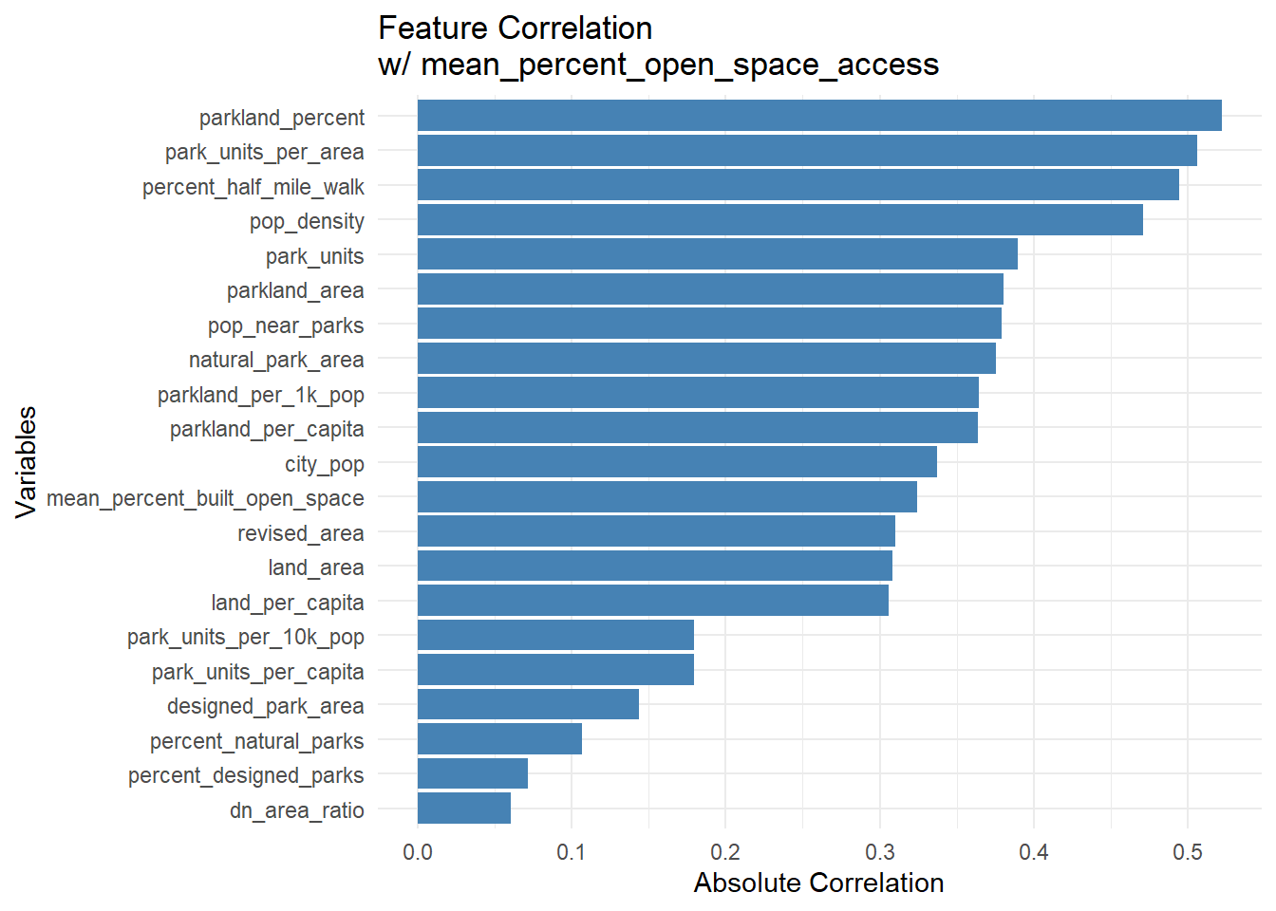
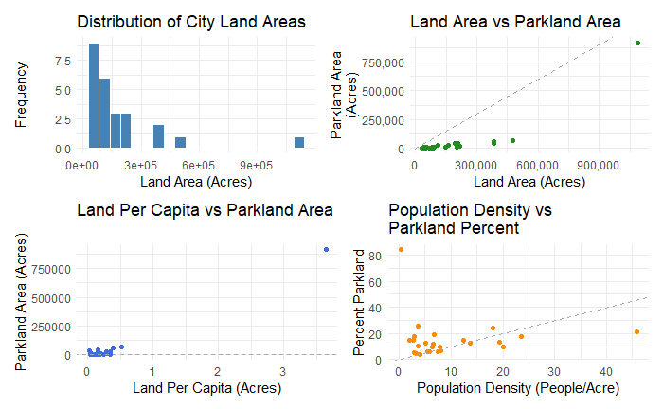
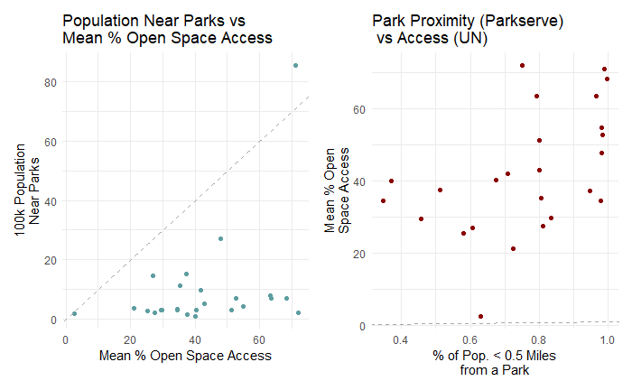
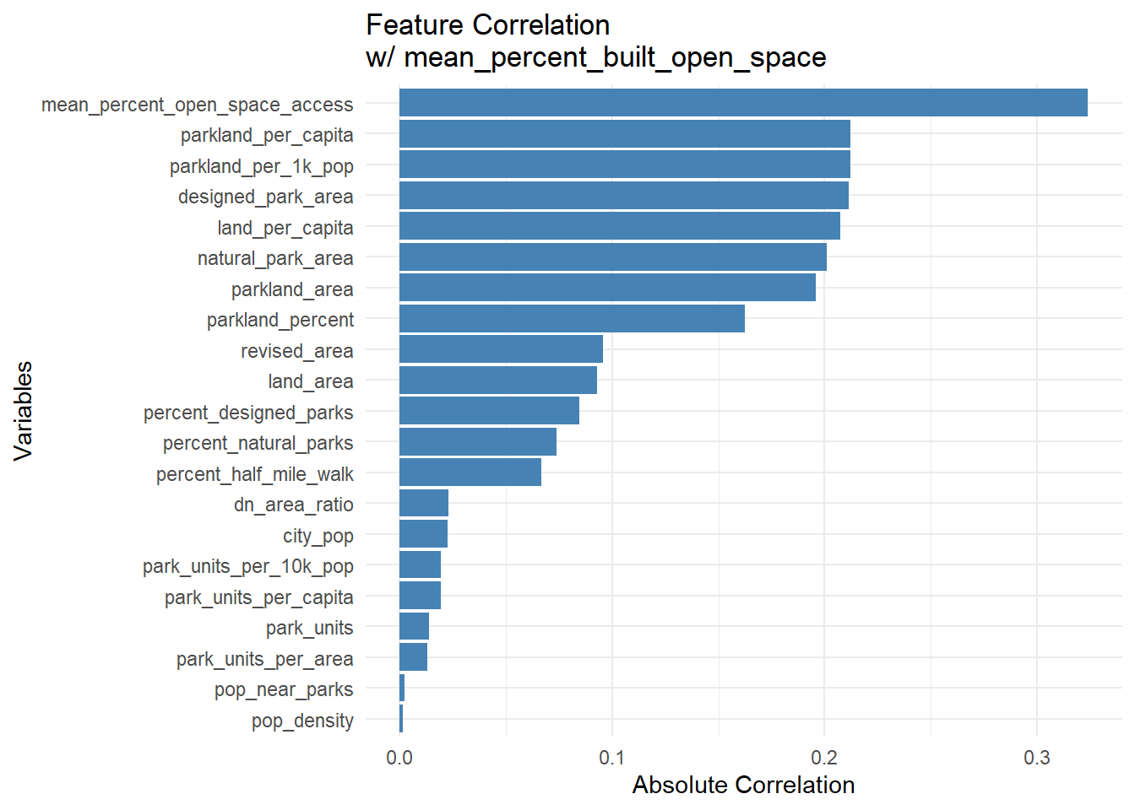
Exploratory Data Analysis

Slide 7
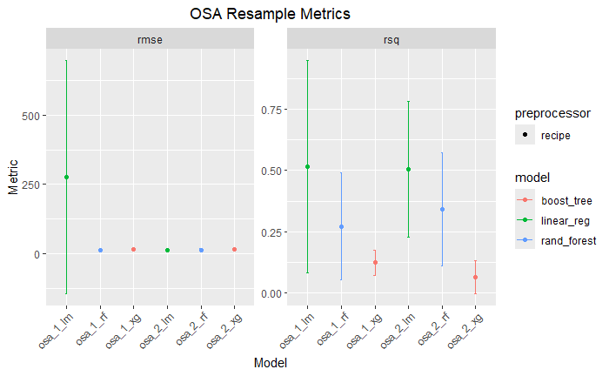
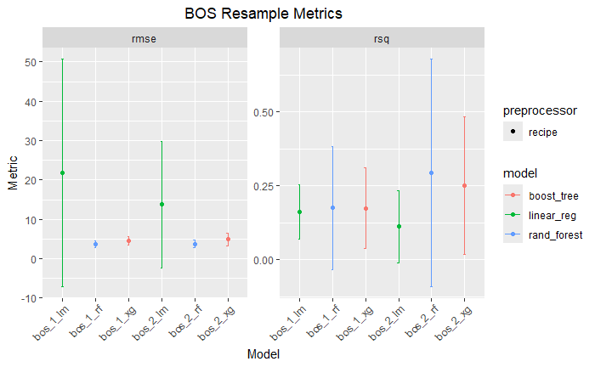
Initial Modeling Results

Slide 8
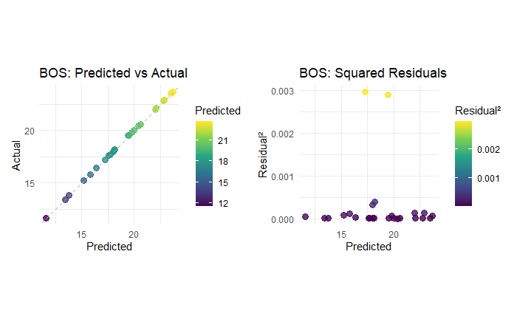
2.7644
Boosted Tree (xgboost)
0.0136
Built Open Space Results
RMSE
Model
R-Squared

Slide 9
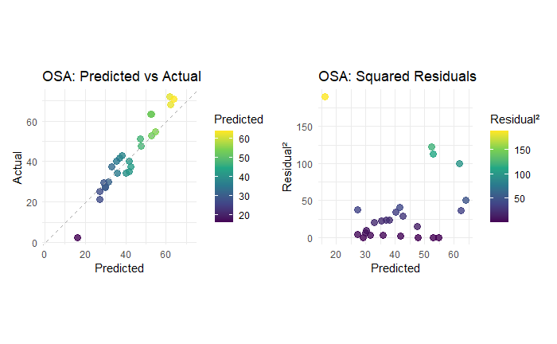
18.5488
Linear Reg. (lm)
0.6653
Open Space Access Results
RMSE
Model
R-Squared

Slide 10
Need a Larger Sample Size
EDA results
01
03
02
Alaska is an outlier
04
No correlation between population and open space
Conclusions

Slide 11
Thanks!
Questions?

